Slide 1
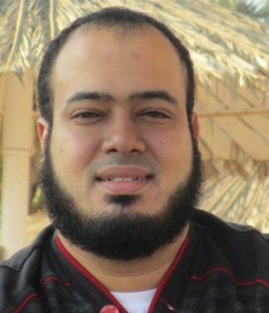
Competitive Programming From Problem 2 Solution in O(1)
P
T
H
I
N
K
F
A
S
T
S
C++: Practice - Calculator V1.0
Mostafa Saad Ibrahim
Teaching Assistant @ Cairo University

Slide 2
Remember
Students grow up = can’t code medium thinking problem
Students grow up = can’t code medium project
Problem: Much knowledge + Little Exercises
Let’s Practice

Slide 3
Calculator V1.0
Business Requirements
Read 2 numbers from user
Provide 4 options: + - * /
Can’t divide by zero
Input Validations
Once in reading 2 numbers
Once in reading target operation
Retry when fail from a reasonable step

Slide 4
The user interface
First thing to think about HOW user interact with program. The CONSOLE.
First: Enter 2 numbers
Second: Enter Number for operation
1 for sum, 2 for subtract, 3 for multiply and 4 for division
If failed anytime, will input same things

Slide 5
User Interface example
Welcome to calculator
Dear User, Please Enter 2 numbers
=> 5 6
Please Enter operation. (1 for +, 2 for -, 3 for *, 4 for /)
=> 1
Result of 5 + 6 is 11

Slide 6
Critical skills to grow up
You should learn 3 skills
Test cases
THINK ahead in all combination of tests user may do
Consider wrong entries NOT just normal flow
Skecthing the big picture of program
Never just start to code. THINK in program elements
Estimate time needed for coding
Typically we do it with large programs

Slide 7
Test Cases
Notes
User could input invalid values twice
We need to restart from good points
Case 1 – Normal Case:
2 Numbers: 5 6
Operation: 1
Result 11

Slide 8
Test Cases
Case 2 – Wrong input Case:
2 Numbers: 5 ali
Msg: Ohh. Please enter 2 correct numbers
2 Numbers: 2 3
Operation: 3
Result 6
And so on

Slide 9
Sketching Program
We need to define variables
Read 2 numbers
Validate them. If wrong, re-enter
Give Menu of options
Read Choice
If invalid, reenter
Validate Divison by zero
Show Result

Slide 10

Variables

Slide 11

Goto for retrial

Slide 12
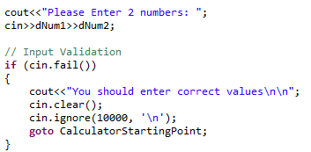
Reading 2 numbers and validation

Slide 13
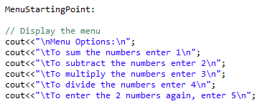
Menu options

Slide 14
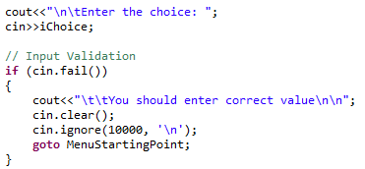
Reading choice and validation

Slide 15
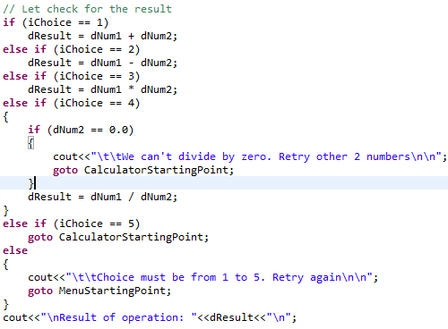
Choices Checking

Slide 16
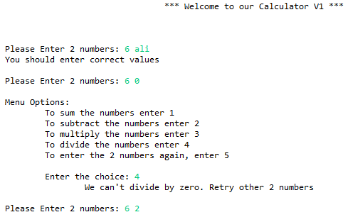
Running

Slide 17
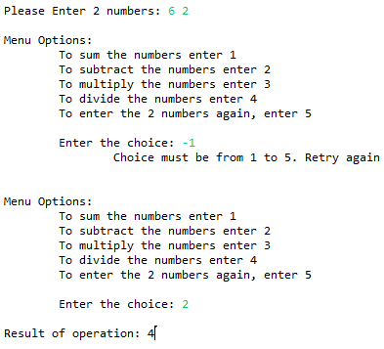
Running

Slide 18
Testing
It is now your role to test program
Never finish code, give basic testing
Good program is robust in all cases

Slide 19
Final notes
If you did not understand..repeat twice
If same, no problem continue
Never focus on getting knowledge ONLY
Practice and Practice and Practice ....OO

